Slide 1



Consumer Goods Ad_Hoc Insights
Presented by : Ravi Rishav

Slide 2
AtliQ’s Business Model
AtliQ Hardware is one of the leading computer hardware producers in India and well expanded in other countries too.
The company specializes in producing and distributing a wide range of high quality hardware products.
Our offerings include personal computers, printers, microphones, and various computer accessories, serving the needs of customers around the world.

Slide 3
Problem Statement
The management observed that they did not have enough insights to make rapid and sensible data-driven decisions.
They intend to grow their data analytics team by adding a few younger data analysts.
Objective
To fulfill 10 ad-hoc business requests, execute SQL queries to extract relevant data and create actionable insights.
The findings will be presented in a dashboard designed specifically for top-level management to facilitate successful data-driven decision-making.

Slide 4

AtliQ’s Product Segmentation
Division | Segment | Category | Product | Variant
P &A - Peripherals and Accessories | Peripherals | 150 | 120 | Standard
PC – Personal Computer | Accessories | 60 | 75 | Plus
N & S – Network and Storage | Notebook | 10 | 15 | Premium
 | Desktop | 90 | 95 | Premium Plus

Slide 5
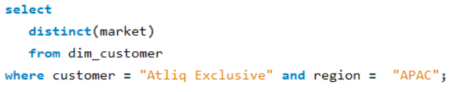
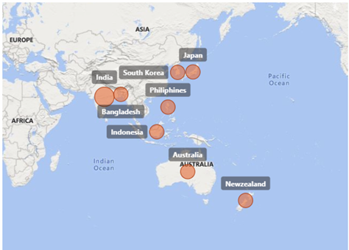
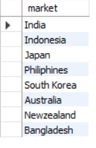


Market Presence of Atliq Exclusive in the APAC Region
Request 1 : Provide the list of markets in which customer "Atliq Exclusive" operates its business in the APAC region.
SQL Query:
Output:
Atliq Exclusive is well-established in 8 APAC (Asia-Pacific) region, including India, Indonesia, Japan, Philippines, South Korea, Australia, New Zealand, and Bangladesh

Slide 6
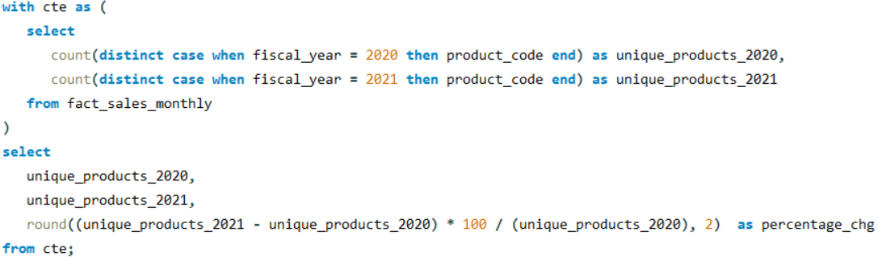
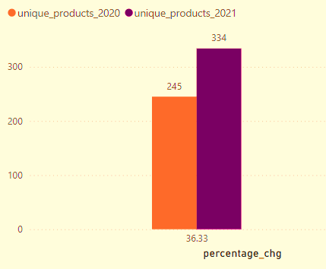
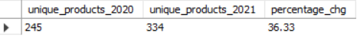
Unique Product Increase (2020 vs. 2021)
Request 2 : What is the percentage of unique product increase in 2021 vs. 2020? The final output contains these fields, unique_products_2020 unique_products_2021 percentage_chg.
SQL Query:
Output:
In 2021, the unique product count rose from 245 to 334,
marking a 36.33% increase compared to the previous year.

Slide 7
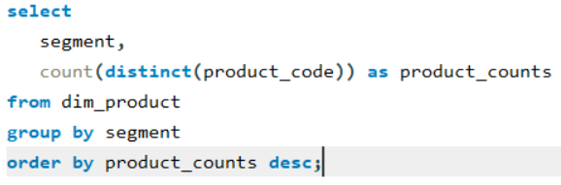
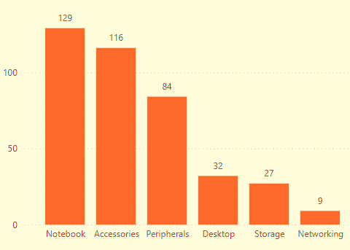
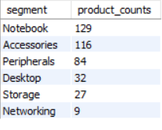
Segment-wise Unique Product Count
Request 3 : Provide a report with all the unique product counts for each segment and sort them in descending order of product counts. The final output contains 2 fields, segment product_count.
SQL Query:
Output:
Out of 6 segments, Notebook had the highest number of products (129), and Networking had the lowest number of products (9).

Slide 8
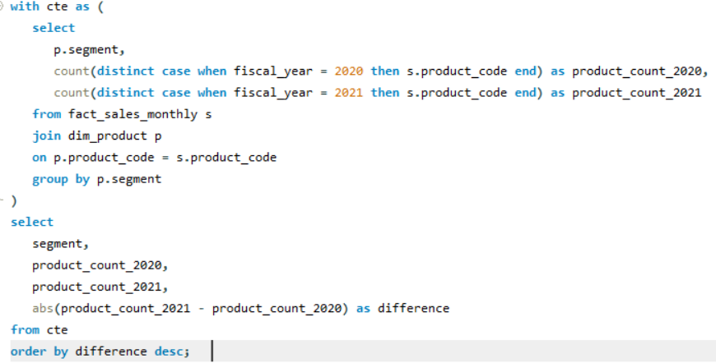
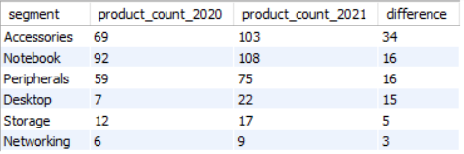
Segment-wise Unique Product Increase (2020 vs. 2021)
Request 4 : Follow-up: Which segment had the most increase in unique products in 2021 vs 2020? The final output contains these fields: segment ,product_count_2020, product_count_2021, difference
SQL Query:
Output:
In 2021, Notebooks added 16 new unique products, reaching108. However, Accessories added 34 products, reaching a total of 103, making it first in terms of growth.

Slide 9
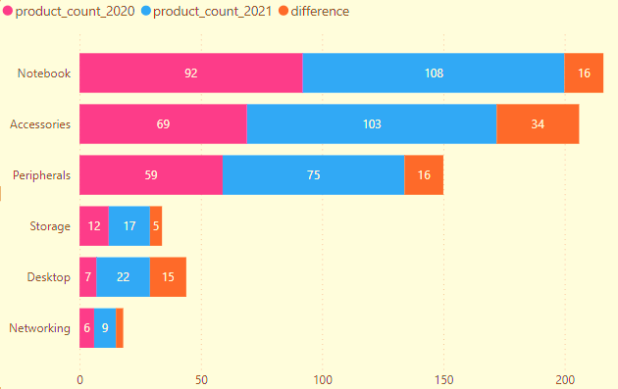
Product Count Change by Segment

Slide 10
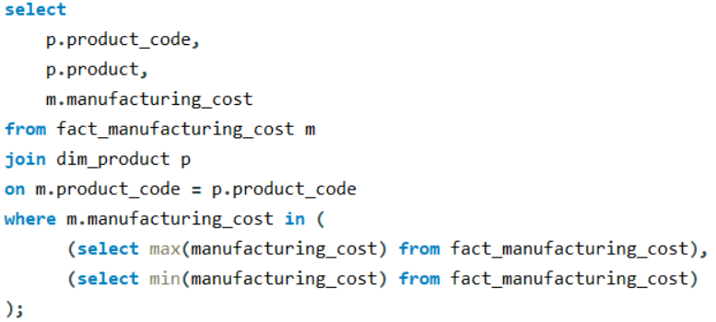
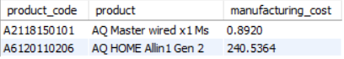

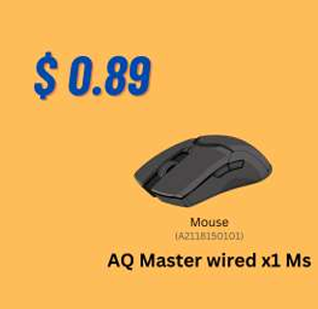
Highest and Lowest Manufacturing Costs for Products
Request 5 : Get the products that have the highest and lowest manufacturing costs. The final output should contain these fields: product_code, product, manufacturing_cost
SQL Query: Output:
'AQ Master wired x1Ms’ had the lowest manufacturing cost with 0.89, 'AQ HOMEAllin1Gen2’ had the highest manufacturing cost at 240.54.

Slide 11
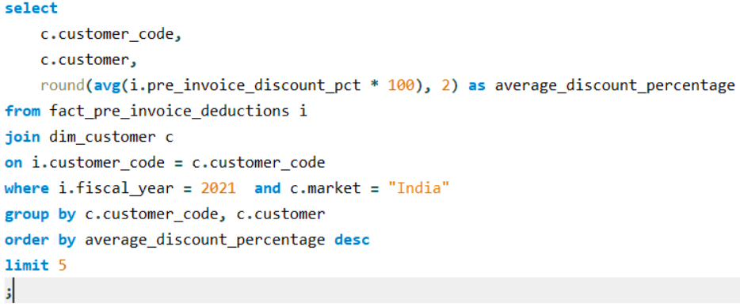
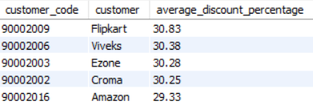
Top 5 Customers with Highest Pre-Invoice Discount Percentage in the Indian Market (Fiscal Year 2021)
Request 6 : Generate a report that contains the top 5 customers who received an average high pre_invoice_discount_pct for the fiscal year 2021 and in the Indian market. The final output contains these fields: customer_code, customer, average_discount_percentage
SQL Query: Output:
In the Indian Market 2021, Flipkart had the highest average pre-invoice discount percentage at 30.83, and Amazon had the lowest at 29.33.

Slide 12
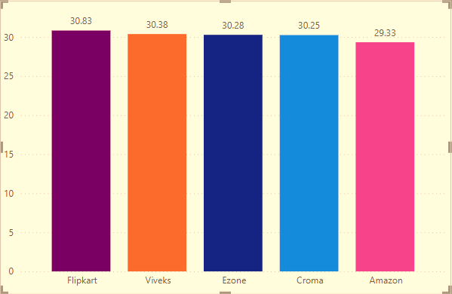
Top 5 Indian Customers By Highest Avg Discounts – FY2021

Slide 13
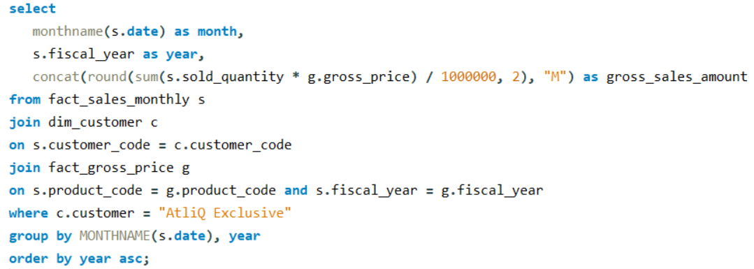
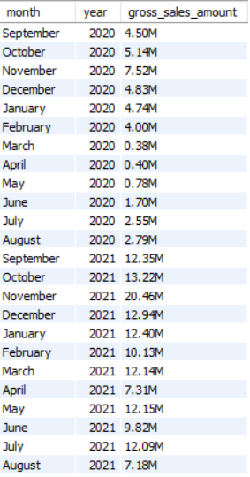
Monthly Gross Sales Analysis for Customer "Atliq Exclusive"
Request 7 : Get the complete report of the Gross sales amount for the customer “Atliq Exclusive” for each month . This analysis helps to get an idea of low and high-performing months and take strategic decisions. The final report contains these columns: Month, Year, Gross sales Amount
SQL Query: Output:
In 2021, gross sales for "Atliq Exclusive" saw a substantial increase compared to 2020.
The highest sales month in 2021 was November (20.46M), nearly 3 times higher than November 2020 (7.52M).

Slide 14
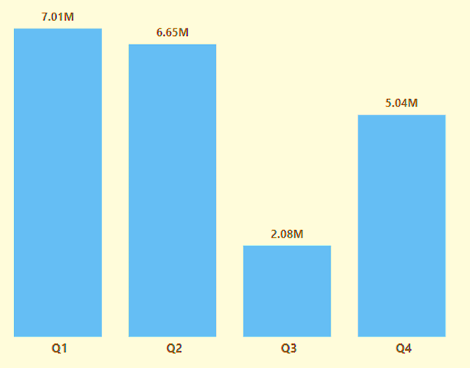
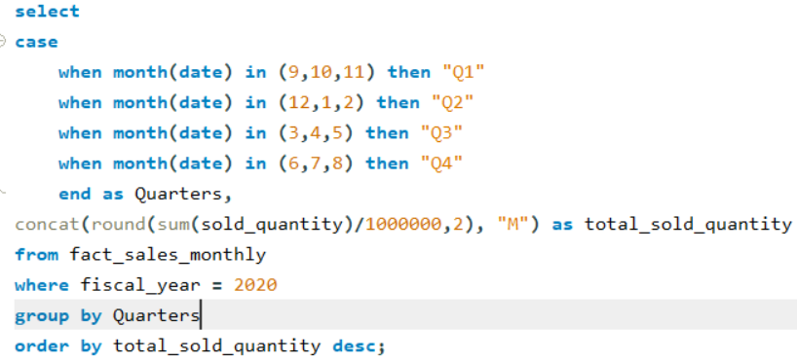
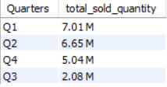
Identifying Quarter with Maximum Total Sold Quantity in 2020
Request 8 : In which quarter of 2020, got the maximum total_sold_quantity? The final output contains these fields sorted by the total_sold_quantity, Quarter total_sold_quantity
SQL Query:
Output:
In 2020, Quarter 1 reports the maximum sold quantity of 7 Million, while Quarter 3 reports the minimum total of 2 Million.

Slide 15
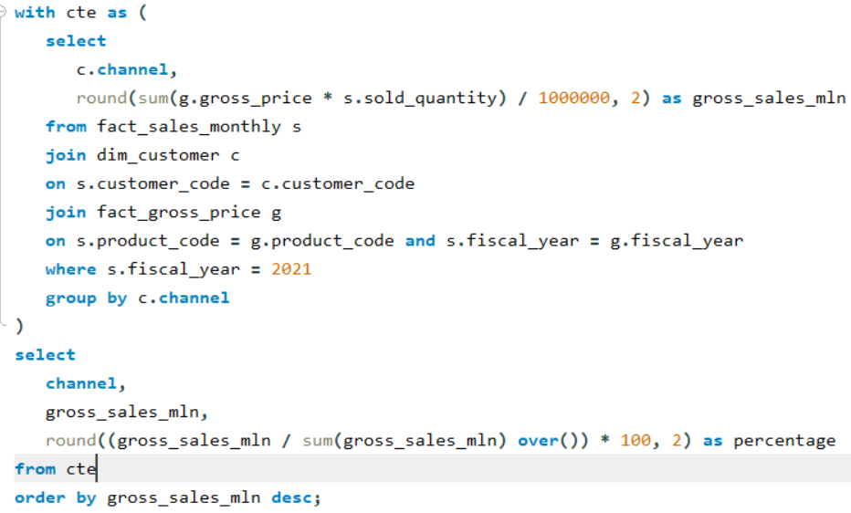
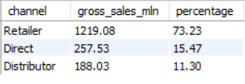
Channel Impact: Fiscal Year 2021 Gross Sales Contribution
Request 9 : Which channel helped to bring more gross sales in the fiscal year 2021 and the percentage of contribution? The final output contains these fields: channel, gross_sales_mln & percentage
SQL Query: Output:
In 2021, Retailer led gross sales with 73.23%, while Direct (15.47%) and Distributor (11.30%) had significantly lower contributions.

Slide 16
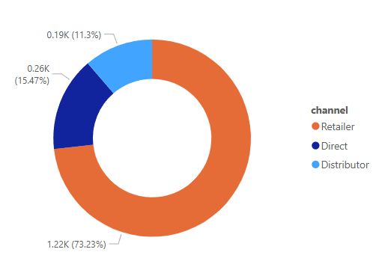
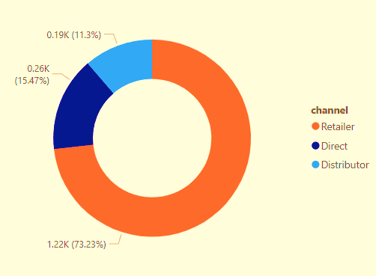
Gross sales and contribution percentages by Channels for FY 2021

Slide 17
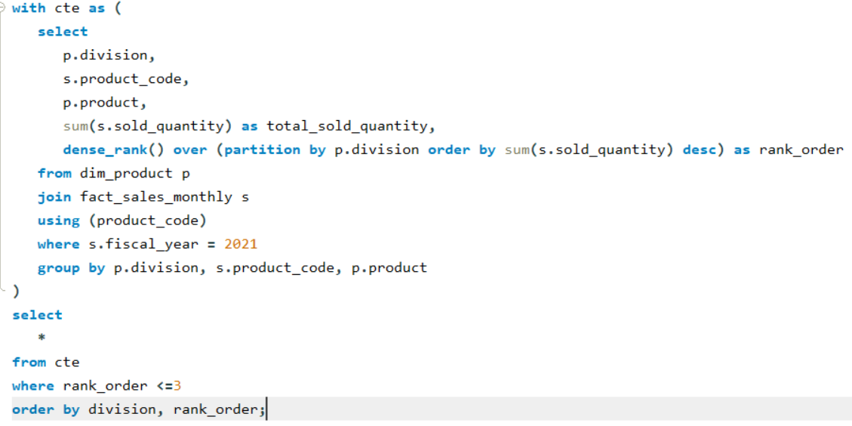
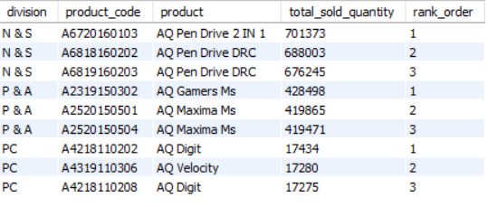
Division-wise Top 3 Products with High Total Sold Quantity (Fiscal Year 2021)
Request 10 : Get the Top 3 products in each division with a high total_sold_quantity in the fiscal_year 2021. The final output contains these fields: division, product_code, product, total_sold_quantity & rank_order
SQL Query: Output:
N & S Division: "AQ Pen Drive 2 IN 1" leads with 701.4K units sold, highlighting strong demand for storage devices.
P & A Division: "AQ Gamers Ms" tops with 428.5K units, indicating high interest in gaming accessories.

Slide 18
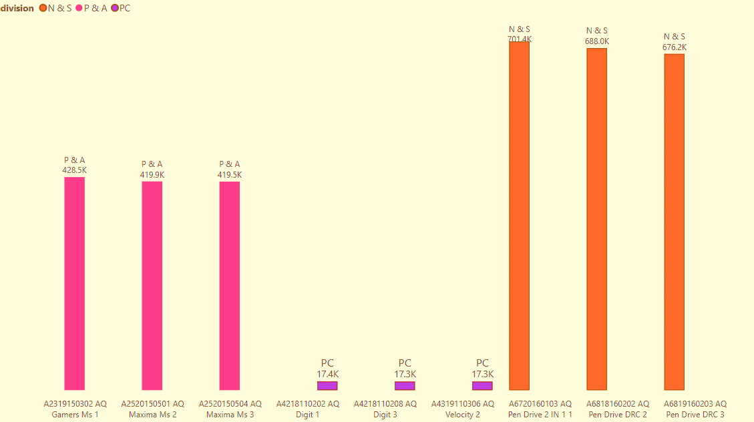
Top 3 highest-selling products by Division for FY 2021

Slide 19
Thank you

